Slide 1
DOTNETVN
MICROSERVICES? WHY IS IT SO POPULAR TODAY?
Author: Linh Pham
Website: http://dotnetvn.com
Facebook Page: https://www.facebook.com/dotnetvn/
Facebook Group: https://www.facebook.com/groups/2358330047574166/
Facebook Profile: https://www.facebook.com/linh.pham.96155

Slide 2
PROBLEM?
APPLICATION
THIRD PARTY
DATABASE 1
DATABASE 2
DATABASE 3
OLD ARCHITECTURE (MONOLITHIC)

Slide 3
1. Business and Data get bigger and bigger day by day
2. Source code is gather one place, in case business is expanded then source is so heavy and hard to maintain and control. Test, debug, CI/CD become more complex.
3. When deploy, administrator have to deploy whole application once time => Will downtime occur?.
5. Bug occurs one place can lead to whole system is stopped.
4. Share or need to integrate to another system?
6. Scale system?
MOVE TO MICROSERVICES

Slide 4
WHAT IS MICROSERVICES?
Microservices is an architectural style that application is separated into small services and theses services have characteristics as below:
Highly maintainable and testable
Loosely coupled
Independently deployable
Organized around business capabilities
Owned by a small team
Many of Tech

Slide 5
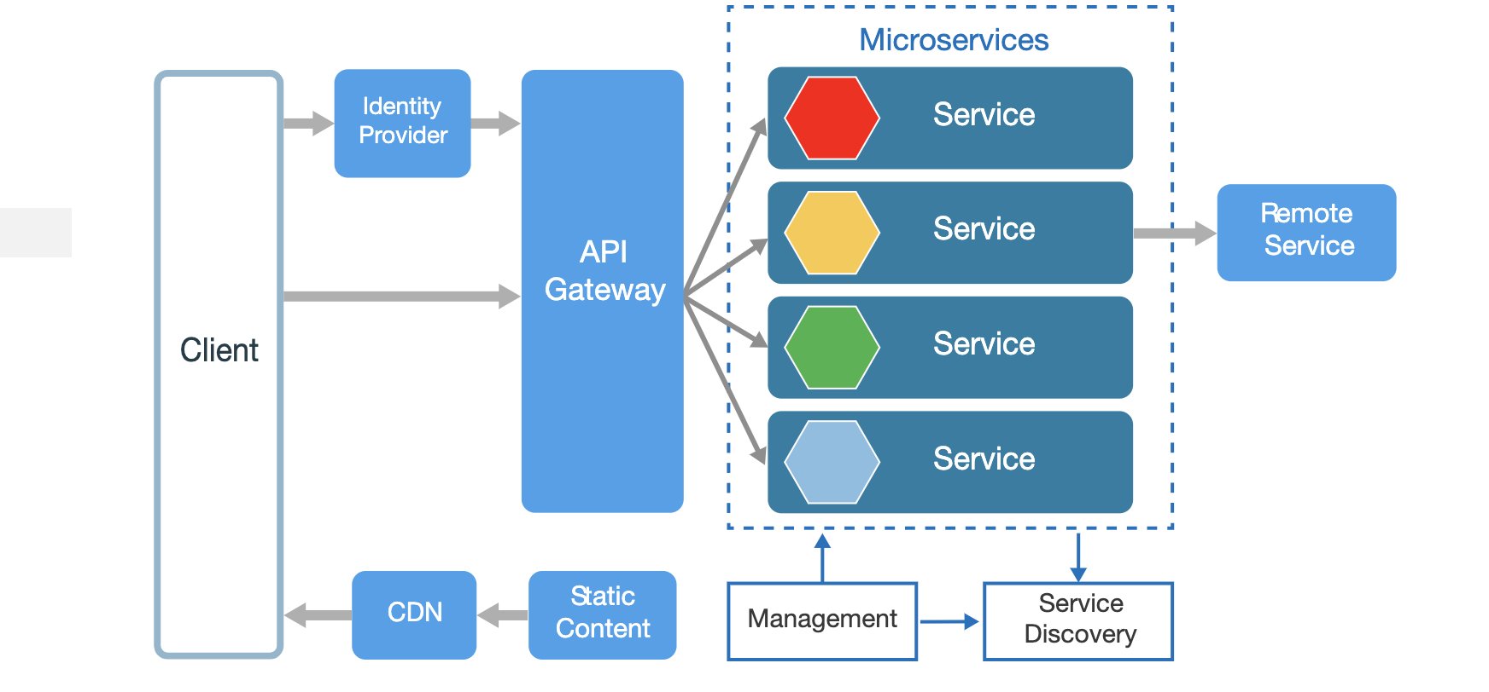
MICRO SERIVICES ARCHITECTURE

Slide 6
DISADVANTAGES OF MICROSERVICE ARCHITECTURE
1. Effort x2 (BE, FE, DEVOPS…)
2. System becomes more complex when the number of services get bigger
3. Services management is more difficult
4. Spend more cost (people, money, devices…)
SUIT FOR BIG SYSTEMS AND LONG TERM CONTINUOUS DEVELOPMENT

Slide 7

THE WRONG THINGS THAT YOU CAN FACE WHEN WORK WITH MICROSERVICES
1. Micro is “As Small As Possible”.
2. Web Service / Web Api is always microservice.
3. Approach microservices via tables in database.
4. Only have one database but always think about microservices (Small project).

Slide 8
HOW TO DEFINE A MICRO SERVICE CORRECTLY?
1. Single Responsibility Principle (SRP).
Every micro service have to have an own specific business, can be run independently and do not depend each other.
2. Try to find out Bounded Context of microservice.
=> Domain approach.
3. Think about Messaging in microservice
=> Data is “Message”. There are 2 type of message: Synchronous and Asynchronous
Synchronous: REST (Request – Response Http) => wait
Asynchronous: AMQP, STOPM, MQTT => not wait
Notes:
AMQP: Advanced Message Queuing Protocol
MQTT: is an OASIS standard messaging protocol for the Internet of Things (IoT)
STOPM: Simple Text Oriented Messaging Protocol

Slide 9
EXCEPTION AND HEALTH CHECK (MUST HAVE)
HEALTH CHECK SYSTEM
EXCEPTION MANAGEMENT
SERVICE 1
SERVICE 2
SERVICE 3
SERVICE 1
SERVICE 2
SERVICE 3

Slide 10
SECURITY
1. Access Token to Authentication And Authorize (JWT)
- Can access tokens be stolen?
- Should lock Token (White list, Black List)?
- Store token short time or long time?
- Should manage token?
- Use many tokens for 1 user?
2. Use API Gateway to hide real endpoints
3. Limit request / IP
4. Enable Cross-Origin Requests (CORS)
5. Use OTP Code (SMS, Email, Smart Device) for important operations

Slide 11
COMMUNICATION BETWEEN MICRO SERVICES
1. Synchronous (Request HTTP) (WAIT)
- Should not use in internal system => create a share component for other services
- Every service must have subscription key => when call service have to provide access token and subscription key
2. Asynchronous (Messaging) (NO WAIT)
- Message Queue
- Real time message

Slide 12
PERFORMANCE TIPS
1. Use CACHING
- In-Memory Cache
- Persistent In-Process Cache
- Distributed Cache
2. Use asynchronous requests
3. Use difference type database for specific purposes
4. Use Load Balancer
5. Focus on Code Quality

Slide 13

Q&A

